Slide 1
Chapter 13
Simple Linear Regression

Slide 2
Learning Objectives
Explain the concept of probabilistic simple linear regression
Describe the assumptions for simple linear regression
Explain the line of the best-fit principle based on Least Squares Method (LSM)
Describe statistical significance in simple linear regression
Explain how to frame hypotheses in simple linear regression
Explain how the research problem is formulated for simple linear regression

Slide 3
Demonstrate the steps used in SPSS to execute simple linear regression
Explain how to analyse and interpret the SPSS outputs for simple linear regression
Explain how the variations are calculated as related to ANOVA statistics
Describe the process to examine the assumptions of simple linear regression
Report the final results of simple linear regression

Slide 4
Introduction
Measure of association merely examines the linear relationship rather explaining any statistical evidence on cause and effect relationship for incorporated variables.
The simple linear regression is an extension of measures of association and is used to predict the value of the dependent variable based on certain values of the independent variable.
Simple regression detects the cause and effect relationship. The independent variable is called predictor and is treated as causal, whereas a dependent variable is considered as caused variable in the analysis.

Slide 5
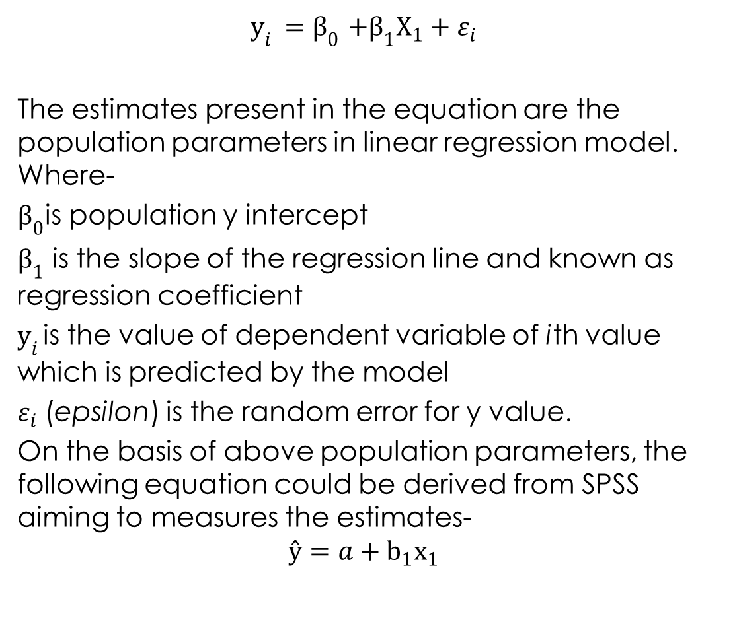
Probabilistic Regression Model

Slide 6
Assumptions for Simple Linear Regression
Absence of outliers: Significant presence of outliers in data affects the predictive accuracy of regression model.
Independent assumption: This assumption confirms that the observations used in the regression are independent to each other.
Linear relationship: A linear relationship exists between the variables. This linear relationship can be assessed by a scatter plot.

Slide 7
Measurement scale: Both dependent and independent variables used in simple regression analysis are continuous in nature and measured at interval or ratio scale.
Homoscedasticity: Homoscedasticity refers to the equally distributed residuals or amount of error in the regression model.
Normal distributed errors: This assumption stresses on the distribution of residuals.

Slide 8
Summary of Assumptions
Table 13.1. Summary of Assumptions for Simple Regression
Assumption | Examine Approach | Measures/Tests
Metric data | Scale of measurement | –
Linear relationship | Graphical method | Scatter plot
Lack of outliers | Graphical method | Box and whisker plot
Lack of autocorrelation | Methodology based | –
 | Numerical method | Durbin–Watson test
Homoscedasticity | Graphical method | Scatter plot (Predicted standardized values and standardized residual)
Normal distributed errors | Graphical method | Normal P–P plots

Slide 9
Linear Regression Method: Line of Best Fit
The prediction accuracy of linear regression model is based on the Line of Best Fit principle that ensures a best approximation of data set used in the study.
In this principle, the regression model is based on LSM. This method is used for two linear associated variables considered between two-dimensional plane (x and y planes).

Slide 10
The best line refers to the line which is very close to the maximum number of points on a scatter plot along with approximately similar number of points above or below the line.

Slide 11
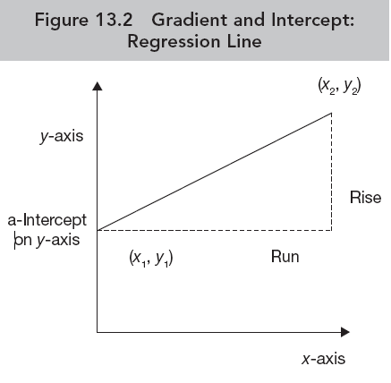
Prediction Accuracy of Straight Line
Gradient: The gradient of a straight line refers to the degree of rises or falls vertically of the line for every data point in xy plane. It is also known as ‘slope’.
Intercept: Intercept is defined as the point where a straight line crosses the horizontal or vertical axes.
The prediction of one dependent variable (Y_{i}) based on the score of independent variable of i_{th} case is expressed as Y_{i} = a + bX_{i} + ε_{i}

Slide 12
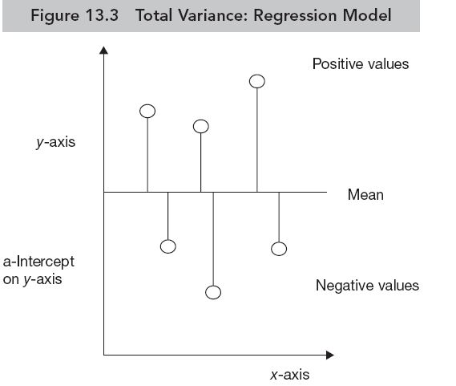
Statistical Significance of Simple Linear Regression
Model Fit: Sum of Squares
Total Sum of Square (SS_{total}): Total sum of square represents the total amount of differences in an observed data in the regression model.

Slide 13
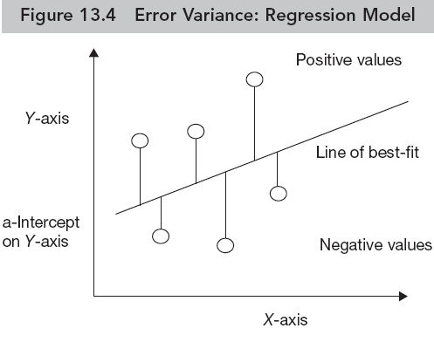
Residual Sum of Square (SS_{residual}): The residual sum of square represents the amount of differences in observed data with respect to best-fit regression line based on the LSM.
Higher the value of SS_{residual}, greater will be inaccuracy of regression model. The same can be illustrated in the diagram as shown in Figure 13.4.

Slide 14
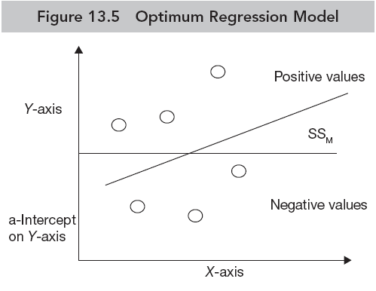
Model Sum of Square (SS_{model}): The model sum of square represents the difference between SS_{total} and SS_{error}. The value of SS_{model} ensures the accuracy of regression model over the basic model.
The SS_{model} indicates the most optimum results with minimizing the residuals. The same can be illustrated in the diagram as shown in Figure 13.5.

Slide 15
Framing Hypothesis in Simple Linear Regression
Hypotheses for relationship between the variables
Null hypothesis H₀: ρ = 0
(No significant correlation exists between variable X and Y or slope of the gradient is equal to zero.)
Alternative hypothesis H_{a}: ρ ≠ 0
(Significant correlation exists between variable X and Y or slope of the gradient is not equal to zero.)

Slide 16
Hypotheses for model-fit
Null hypothesis: The regression model does not predict significantly as compared to base model.
Alternative hypothesis: The regression model predicts significantly as compared to base model.

Slide 17
Hypotheses for significance of model parameters
Null hypothesis: There is no significant effect of predictor on the outcome variable.
Alternative hypothesis: There is significant effect of predictor on the outcome variable.

Slide 18
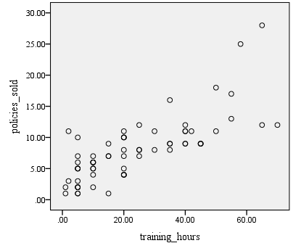
Executing Simple Linear Regression with SPSS Procedure
Assessing Linear Relationship
A linear relationship between insurance policies sold and training hours spent can be seen in the scatter plot as shown in the Figure.

Slide 19
SPSS Path for Descriptive Statistics, Correlation and Regression Coefficients
Exhibit 13.1. Use insurance.sav » Menu bar » analyse » Regression » Linear regression » Select policy_sold and transfer to Dependent box » Select training hours and transfer to Independent box » Click Statistics and select Estimates (Regression Coefficient), Model fit and Descriptives » Click OK

Slide 20
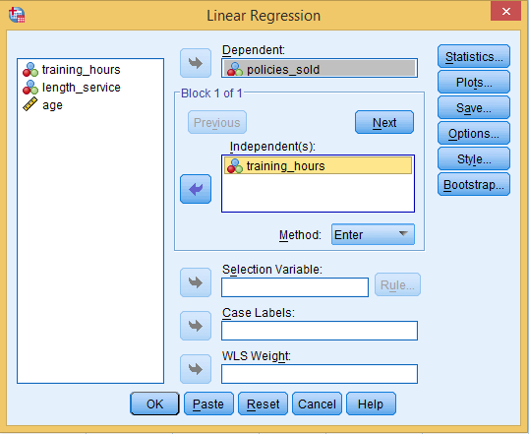
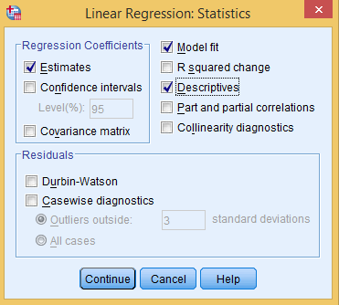

Slide 21
Interpreting Outputs of Simple Linear Regression
Descriptive Statistics of Sample­
Table 13.2a. Descriptive Statistics: Simple Linear Regression
 | Mean | Std. Deviation | N
Policies sold | 8.0 | 5.11 | 65
Training hours | 23.86 | 18.45

Slide 22
Pearson Moment Correlation Coefficient­
Table 13.2b. Correlation Coefficient: Simple Linear Regression
 |  | Training Hours | Income
Policies sold | Pearson correlation (r) | 1 | 0.764*
 | Sig. (2-tailed) |  | 0.000
*Correlation is significant at the 0.01 level (2-tailed).
Sale of policies is strong positively associated (r = 0.764) to the training hours. The lower value (p < 0.01, 0.000) of Sig. (2-tailed) also indicates that the association is significant at 1 per cent LoS.

Slide 23
Method of Regression
Table 13.2c. Regression Methods
Enter Method
Model | Variables Entered | Variables Removed | Method
1 | Training hours | -------- | Enter
Dependent variable: Numbers of insurance policies sold

Slide 24
Model Summary
Table 13.2d. Model Summary: Simple Linear Regression
Model Summary
Model | R | R Square | Adjusted R Square | Std. Error of the Estimate
1 | 0.764ª | 0.583 | 0.577 | 3.32
ªPredictors: (Constant), Training hours

Slide 25
Model Fit
Table 13.2e. ANOVA Table: Simple Linear Regression
ANOVA¹
Model |  | Sum of Squares | Df | Mean Square | F | Sig.
1 | Regression (SS_{model}) | 977.590 | 1 | 977.590 | 88.253 | 0.000
 | Residual(SS_{residual}) | 697.856 | 63 | 11.077
 | Total (SS_{total}) | 1675.446 | 64
F-statistic is calculated by computing the ratio of SS_{model} and SS_{residual}. The p-value (appears at last column) associated with F-statistic is less than 0.05 [F(1,63) = 0.000, p < 0.05)] at 5 per cent LoS, hence we reject the null hypothesis indicating that the regression model does not predict significantly.

Slide 26
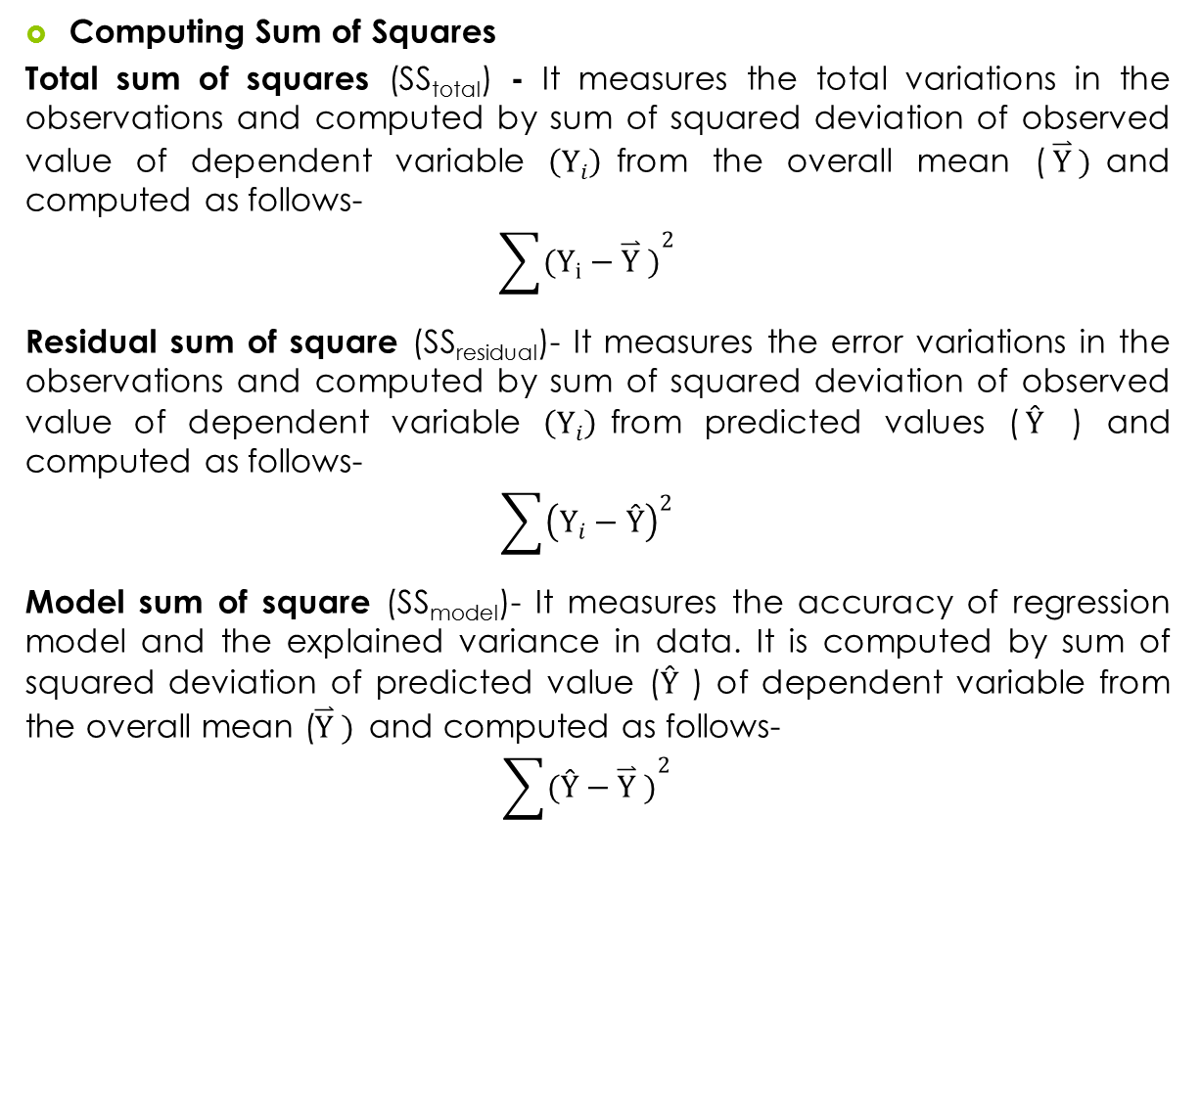
Calculations for ANOVA Table

Slide 27
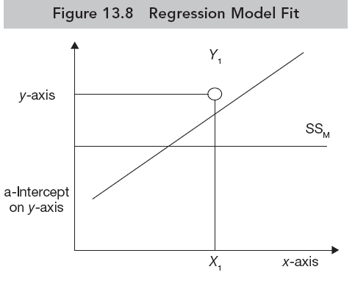
Graphic of Variations

Slide 28
Regression Estimates
Table 13.2f. Regression Coefficients: Simple Linear Regression
Model |  | Unstandardized Coefficients |  | Standardized Coefficients | t | Sig.
 |  | B | Std. Error | Beta
1 | (Constant) | 3.040 | 0.678 |  | 4.48 | 0.000
 | Training hours | 0.212 | .023 | 0.764 | 9.39 | 0.000
As the p-value associated to t-statistics is less than 0.05 (t = 9.39, p < 0.05, 0.000), we reject the null hypothesis of no significant effect of predictor on the outcome variable and conclude that the training hours significantly affect the number of policies sold by the insurance agents.

Slide 29
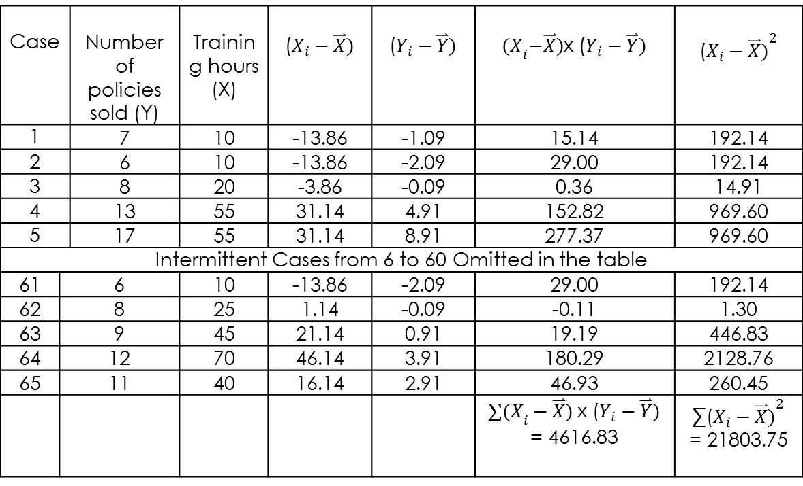
Sample Data Illustration
Table 13.3. Sample Data Illustration: Regression Coefficients
Case |  | Number of Policies Sold (Y) | Training Hours (X)
1 |  | 7 | 10 | −13.86 | −1.09 | 15.14 | 192.14
2 |  | 6 | 10 | −13.86 | −2.09 | 29.00 | 192.14
3 |  | 8 | 20 | −3.86 | −0.09 | 0.36 | 14.91
4 |  | 13 | 55 | 31.14 | 4.91 | 152.82 | 969.60
5 |  | 17 | 55 | 31.14 | 8.91 | 277.37 | 969.60
Intermittent cases from 6 to 60 omitted in the table
61 | 6 |  | 10 | −13.86 | −2.09 | 29.00 | 192.14
62 | 8 |  | 25 | 1.14 | −0.09 | −0.11 | 1.30
63 | 9 |  | 45 | 21.14 | 0.91 | 19.19 | 446.83
64 | 12 |  | 70 | 46.14 | 3.91 | 180.29 | 2128.76
65 | 11 |  | 40 | 16.14 | 2.91 | 46.93 | 260.45

Slide 30
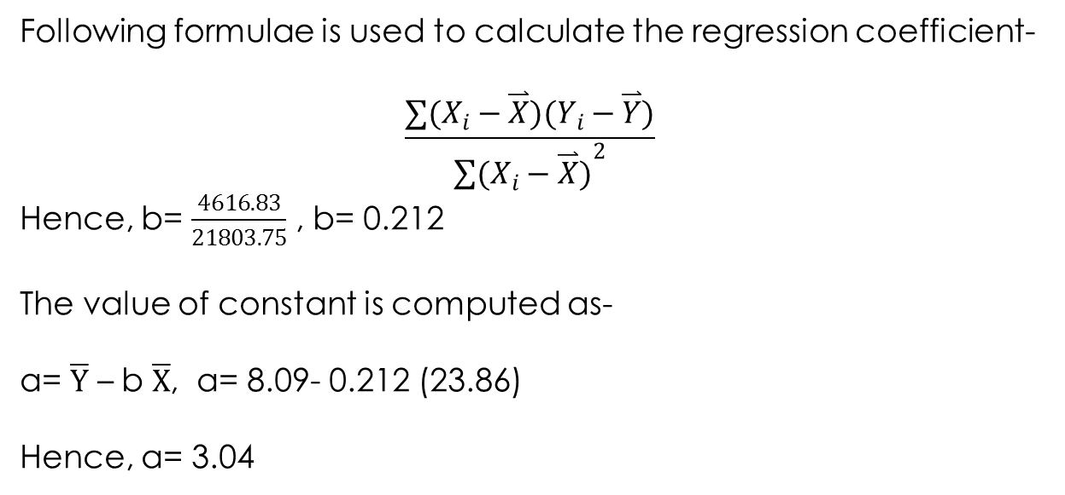
Formulae for Regression Coefficient

Slide 31
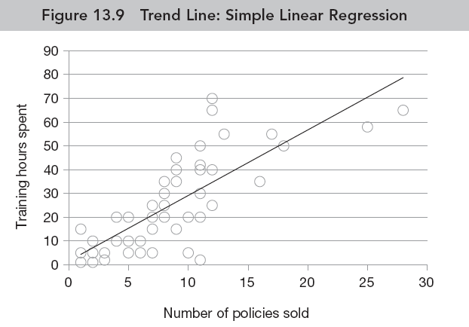
Regression Equation and Trend Line
Number of Policies (ŷ) = a + b₁ (training hours)
= 3.04 + 0.212 (training hours)

Slide 32
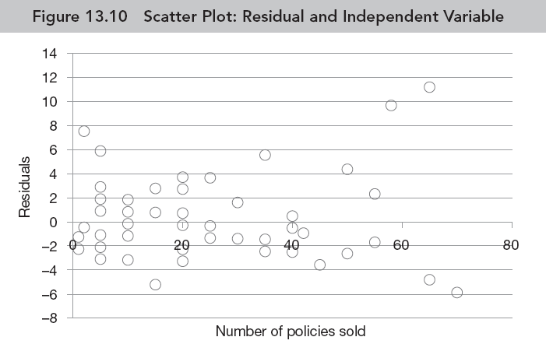
Examine the Assumptions of Regression: Residual Analysis
Assumption of linearity of regression model: This assumption can be checked by plotting the scatter graph between residuals and each value of the independent variable.
The emergence of ‘no specific pattern’ indicates the linear relationship of regression model.

Slide 33
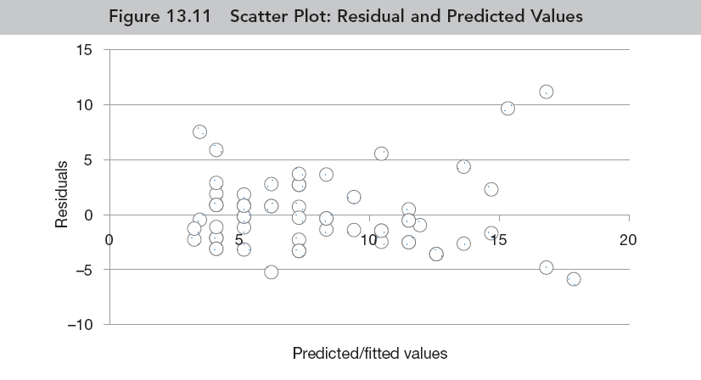
Assumption of homoscedasticity: The assumption of homoscedasticity refers to the equally distributed residuals or amount of error in the regression model. This assumption verifies whether the variation of residual is constant or similar at each point of derived model.
The scatter plot indicates the assumption of homoscedasticity as the residuals are randomly scattered around Zero.

Slide 34
Assumption of independence of error: This assumption ensures no relationship between error (ε_{i}) value of any independent variable to the other value of error belonging to another independent variable. The Durbin–Watson test is used to examine the autocorrelation in the sample data (refer Chapter 17).
Assumption of normal distributed errors
Exhibit 13.2. Click Plot of main dialog box of Linear Regression » Transfer ZRESID into Y axis and ZPRED into X axis » Select Normal probability plot » Continue » Click OK

Slide 35
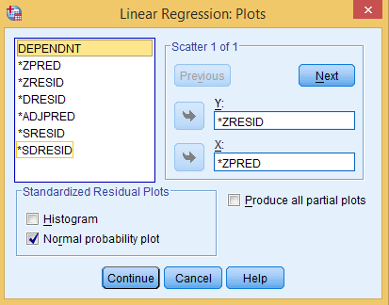
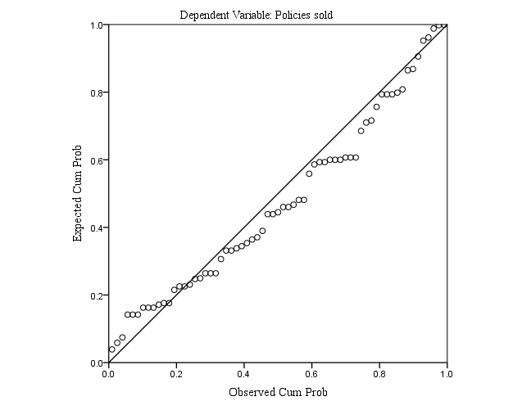

Slide 36
Reporting the Results of Simple Linear Regression
A strong positive Pearson’s product moment correlation exists (r = 0.764; p < 0.01, 0.000) between number of policies sold (Y) and training hours (X).
The value of R square indicates that 58 per cent of the variance in the sale of insurance policies is explained by the training hours spent by the agents.
The p-value associated to t-statistics is less than 0.05 (t = 9.39, p < 0.05, 0.000) at 5 per cent LoS. Hence, we reject the null hypothesis of no significant effect of predictor on the outcome variable.

Slide 37
Key Terms
Adjusted R Square Base line model Best-fit principle Gradient Homoscedasticity Intercept Least square method Model Fit Model parameters | Normally distributed errors R Square Regression Equation Regression Estimates Residual Simple linear regression standardized residual Trend Line
Lokesh Jasrai (2020), SAGE TEXTS

